Slide 1
CNN Deep Learning
CONVOLUTIONAL NEURAL NETWORKS
By
Siva K [24MCR101]

Slide 2
Introduction to CNN
Yann LeCun, director of Facebook’s AI Research Group, pioneered convolutional neural networks
In 1988, he built the first one, LeNet, which was used for character recognition tasks like reading zip codes and digits.
Have you ever wondered how facial recognition works on social media, or how object detection helps in building self-driving cars, or how disease detection is done using visual imagery in healthcare? It’s all possible thanks to convolutional neural networks (CNN).

Slide 3
What is Convolutional Neural Network?
A convolutional neural network is a feed-forward neural network that is generally used to analyze visual images by processing data with grid-like topology.
It’s also known as a ConvNet.
A convolutional neural network is used to detect and classify objects in an image
In the next slide, a neural network that identifies two types of flowers: Orchid and Rose.

Slide 4
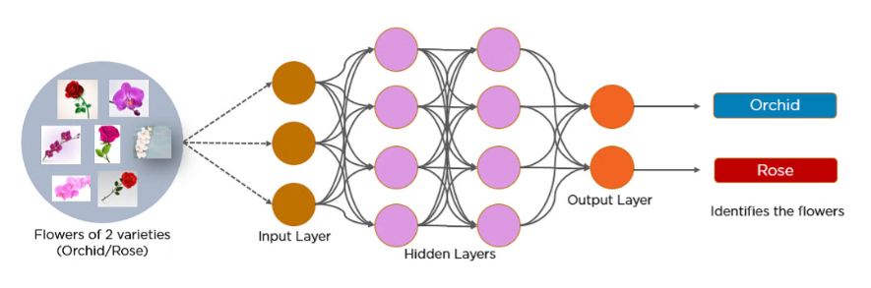

Slide 5
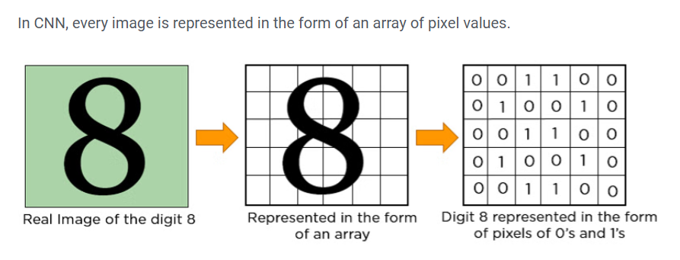

Slide 6
Layers in a Convolutional Neural Network
A convolution neural network has multiple hidden layers that help in extracting information from an image. The four important layers in CNN are:
Convolution layer
ReLU layer
Pooling layer
Fully connected layer
ReLU layer/ Activation Layer
Flattening
Output Layer

Slide 7
Advantages of CNN
High Accuracy
Efficiency
Robustness
Flexibility

Slide 8
Disadvantages of Convolutional Neural Networks (CNNs)
Complexity and Training Difficulty
High Computational Demands
Large Data Requirements
Lack of Interpretability

Slide 9
conclusion
Convolutional Neural Networks (CNNs) have become one of the most powerful and widely used architectures in deep learning, particularly for tasks involving images, video, and spatial data.
By automatically learning hierarchical feature representations through convolution, pooling, and non-linear activation layers, CNNs eliminate the need for manual feature extraction.
Their ability to capture local patterns and scale them into more abstract, high-level features makes them highly effective for computer vision tasks such as image classification, object detection, and segmentation.
Beyond vision, CNNs are also applied in natural language processing, medical imaging, and speech recognition, proving their versatility.

